Slide 1
Data Structures and Algorithms
Lecture 4: Queues (队列)
Data Science
United International College

Slide 2
Outline
Queue Abstract Data Type (ADT)
Basic operations of queues
Applications of queues
Implementations of queues

Slide 3
Queue ADT
Like a stack, a queue is also a list.
However, within a queue
  insertion is done at one end, i.e., the rear (尾部)
  deletion is performed at the other end, i.e, the front (前端)
dequeue
3 | 4 | 8 | … | 6
enqueue
front
rear

Slide 4
Queue Animation
http://www.cs.armstrong.edu/liang/animation/web/Queue.html
Queues are known as FIFO (First In, First Out) lists.

Slide 5
Enqueue and Dequeue
Primary operations: Enqueue (入列) and Dequeue (出列)
Enqueue:
  insert an element at the rear of the queue
Dequeue
  remove an element from the front of the queue

Slide 6
Enqueue and Dequeue
 | A
 | A | B
Empty queue
Enqueue(A)
Enqueue(B)
 | A | B | C
 | B | C
 | C
Enqueue(C)
Dequeue()
Dequeue()

Slide 7
Queue Applications
Printer Queue
  When jobs are submitted to a printer, they are arranged in order of arrival. Thus, essentially, jobs sent to a printer are placed on a queue.
Web Crawler
  Basic web crawler operation will begin with “seed” URLs.
  Fetch and parse them, then extract URLs they point to and place the URLs on a queue.
  Fetch each URL on the queue and repeat.
System Buffer
  Buffers are used in computers as a temporary memory area, usually used in a FIFO (first in, first out) method, outputting data in the order it arrived.
Any sequence maintained in a FIFO order
Notes:
Because the processes of reading and writing data to a disk are relatively slow, many programs keep track of data changes in a buffer and then copy the buffer to a disk. For example, word processors employ a buffer to keep track of changes to files. Then when you save the file, the word processor updates the disk file with the contents of the buffer. This is much more efficient than accessing the file on the disk each time you make a change to the file.

Slide 8
Implementation of Queues
Recall the reason why we usually
  Implement a list using linked lists?
  Implement a stack using array?
Topic |  | Array | Linked List
Efficiency | Enqueue
 | Dequeue
space
Notes:
As with stacks, any list implementation is legal for queues.
Like stacks, both the linked list and array implementations give fast O(1) running times for every operation.
The linked list implementation is straightforward and left as an exercise. We will now discuss an array implementation of queues.

Slide 9
Queue Implementation
There are several different algorithms to implement Enqueue (入队) and Dequeue (出队)
Naïve way: in Enqueue
  the front index is always fixed
  the rear index moves forward in the array.
rear=-1
rear=0
rear=1
rear=2
3
3
6
3
6
9
front=0
front=0
front=0
front=0
Enqueue(3)
Enqueue(6)
Enqueue(9)
Notes:
For an empty queue, the front is 0, and rear is -1.

Slide 10
Queue Implementation
Naïve way: in Dequeue
  the front index is fixed
  the element at the front of the queue is removed
  Move all the elements after it by one position.
rear=2
rear=1
rear=0
rear= -1
3
6
9
6
9
9
front=0
front=0
front=0
front=0
Dequeue()
Dequeue()
Dequeue()
10

Slide 11
Queue Implementation
Naïve way: not efficient for Dequeue operation.
A Better Array Implementation
  When an item is enqueued, the rear index moves forward.
  When an item is dequeued, the front index also moves forward by one element
rear=1
rear=2
rear=2
rear=2
3
3
6
6
front=1
front=1
front=2
front = 3
Enqueue(6)
Dequeue()
Dequeue()
11

Slide 12
Queue Implementation
Naïve way: not efficient for Dequeue operation.
A Better Array Implementation
  Efficient, but what’s the problem? (After several dequeue operations, how to insert a new data into the queue?)
rear=1
rear=2
rear=2
rear=2
3
3
6
6
front=1
front=1
front=2
front = 3
Enqueue(6)
Dequeue()
Dequeue()
12
Notes:
After several enqueues, the queue appears to be full, since rear is now at the last array index, and the next enqueue would
be in a nonexistent position.
However, there might only be a few elements in the queue, because several elements may have already been dequeued.

Slide 13
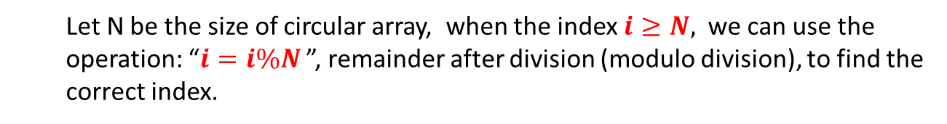
A Circular Array
Circular array (环形数组)
  When an element moves past the end of a circular array, it wraps around to the beginning
6
5
4
9
3
6
4
0
3
1
2
  Index Growth: 0 → 1 → 2 → 3 → 4 → 5 → 6 → 0 → …
  Let N be the size of circular array, when the index $i≥N,$we can use the operation: “$i=i\%N$ ”, remainder after division (modulo division), to find the correct index.
13
Notes:
After several enqueues, the queue appears to be full, since rear is now at the last array index, and the next enqueue would
be in a nonexistent position.
However, there might only be a few elements in the queue, because several elements may have already been dequeued.

Slide 14
A Circular Array - Enqueue
rear=1
6
front=1
rear=2
rear=0
rear=0
6
4
3
6
4
3
6
4
front=1
front=1
front=1
Eequeue(4)
Eequeue(3)
Eequeue(1) Fails
14
Notes:
It is full, so enqueuer will fail

Slide 15
A Circular Array - Dequeue
rear=2
3
6
9
front=0
rear=2
rear=2
rear=2
6
9
9
front=1
front=2
front=0
Dequeue()
Dequeue()
Dequeue()
15

Slide 16
A Circular Array – Empty or Full
How to detect an empty or full queue using a circular array?
  Empty: rear is one position before front
  Full: rear is one position before front
Is this queue empty or full?
How to detect an empty or full queue, using a circular array algorithm?
  Use a counter which records number of elements in the queue
rear=0
3
6
4
front=1
16
Notes:
After several enqueues, the queue appears to be full, since rear is now at the last array index, and the next enqueue would
be in a nonexistent position.
However, there might only be a few elements in the queue, because several elements may have already been dequeued.

Slide 17
Queue Implementation with Array
Data
  front: index of the front
  rear: index of the rear
  counter: number of elements in the queue
  maxSize: maximum size of the queue
  values: can be of any data type but we use double for demonstration
typedef struct{
double* values;
int front;
int rear;
int counter;
int maxSize;
} Queue;

Slide 18
Queue Implementation with Array
Methods
bool CreateQueue(Queue *queue, int size);
bool IsEmpty(Queue* queue);
bool IsFull(Queue* queue);
bool Enqueue(Queue* queue, double x);
bool Dequeue(Queue* queue, double* x);
void DisplayQueue(Queue* queue);
void DestroyQueue(Queue* queue);

Slide 19
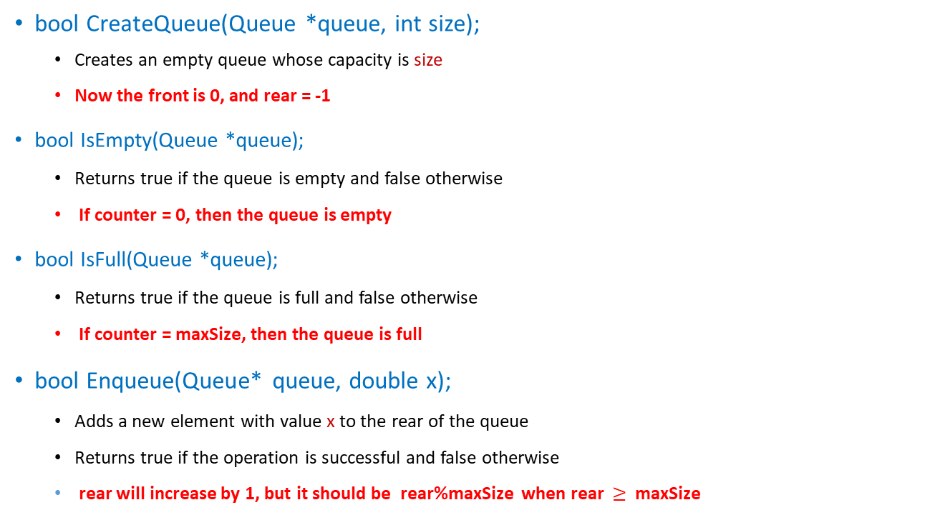
Methods
bool CreateQueue(Queue *queue, int size);
  Creates an empty queue whose capacity is size
  Now the front is 0, and rear = -1
bool IsEmpty(Queue *queue);
  Returns true if the queue is empty and false otherwise
  If counter = 0, then the queue is empty
bool IsFull(Queue *queue);
  Returns true if the queue is full and false otherwise
  If counter = maxSize, then the queue is full
bool Enqueue(Queue* queue, double x);
  Adds a new element with value x to the rear of the queue
  Returns true if the operation is successful and false otherwise
  rear will increase by 1, but it should be rear%maxSize when rear $≥$ maxSize

Slide 20
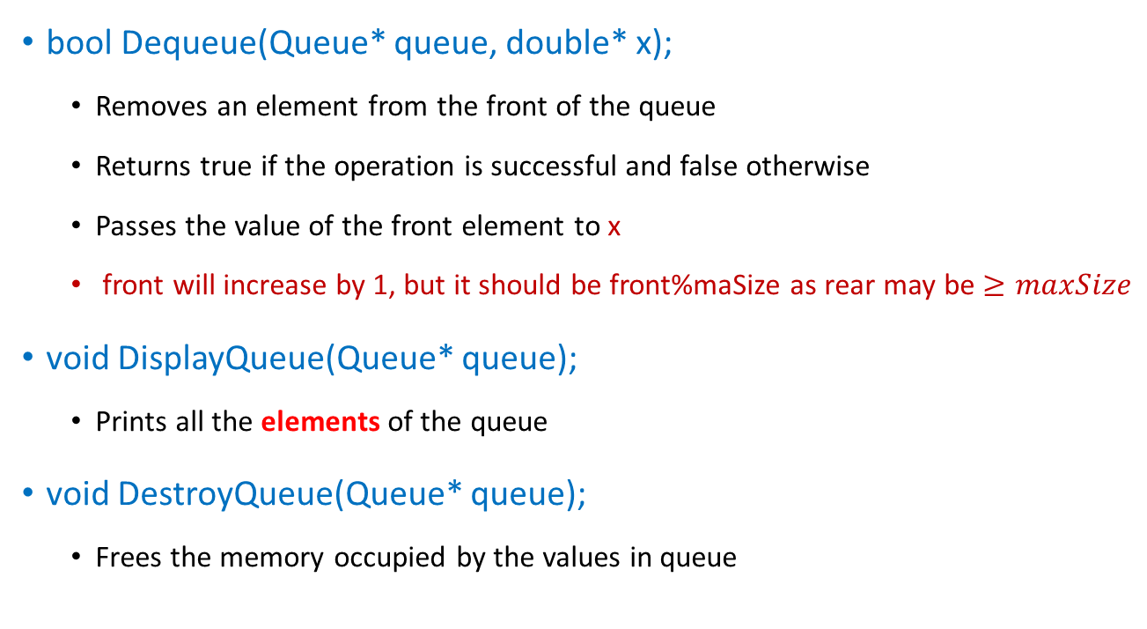
Methods
bool Dequeue(Queue* queue, double* x);
  Removes an element from the front of the queue
  Returns true if the operation is successful and false otherwise
  Passes the value of the front element to x
  front will increase by 1, but it should be front%maSize as rear may be $≥maxSize$
void DisplayQueue(Queue* queue);
  Prints all the elements of the queue
void DestroyQueue(Queue* queue);
  Frees the memory occupied by the values in queue

Slide 21
CreateQueue
#include <stdlib.h>
bool CreateQueue(Queue *queue, int size){
  if (size <= 0)
  return false;
  queue->values = (double*)malloc(sizeof(double)*size);
  queue->front = 0;
  queue->rear = -1;
  queue->counter = 0;
  queue->maxSize = size;
  return true;
}
Why?
Any other valid initialization?
Notes:
Initialize front = 0 and rear = -1 => when enqueue, firstly increment the rear by 1 and add the value to values[rear] (rear denotes the last position of current queue, front denotes the first element if the queue is not empty)
Can initialize front = -1 and rear = -1 => when dequeue, firstly increment front by 1 and then get the value; display, also increment front by 1 and start display.
Can initialize front = 0 and rear = 0 => when enqueue, firstly add the value to current rear and then add rear by 1.

Slide 22
Enqueue
bool Enqueue(Queue* queue, double x){
  if(IsFull(queue))
  return false;
  queue->rear = queue->rear + 1;
  queue->rear = queue->rear%queue->maxSize;
  queue->values[queue->rear] = x;
  queue->counter++;
  return true;
}
rear moves forward one position
Circular array index

Slide 23
Using queue
#include "queue.h"
#include<stdio.h>
int main(void) {
Queue queue;
double value;
CreateQueue(&queue, 5);
puts("Enqueue 5 items ...");
for (int x = 0; x < 5; x++)
Enqueue(&queue, x);
DisplayQueue(&queue);
puts( "Now attempting to enqueue 5 ...");
Enqueue(&queue, 5);
DisplayQueue(&queue);
Dequeue(&queue, &value);
printf("Retrieved element = %f\n", value);
while(!IsEmpty(&queue))
Dequeue(&queue, &value);
DisplayQueue(&queue);
puts( "Now attempting to enqueue 7 ...");
Enqueue(&queue, 7);
DisplayQueue(&queue);
DestroyQueue(&queue);
DisplayQueue(&queue);
}

Slide 24
Task
Write queue.h and queue.cpp which implement the queue data structure.
Refer to list.h and write proper comments in queue.h to describe every function.
Compress queue.h and queue.cpp to a .zip file and submit it to iSpace.

